Slide 1
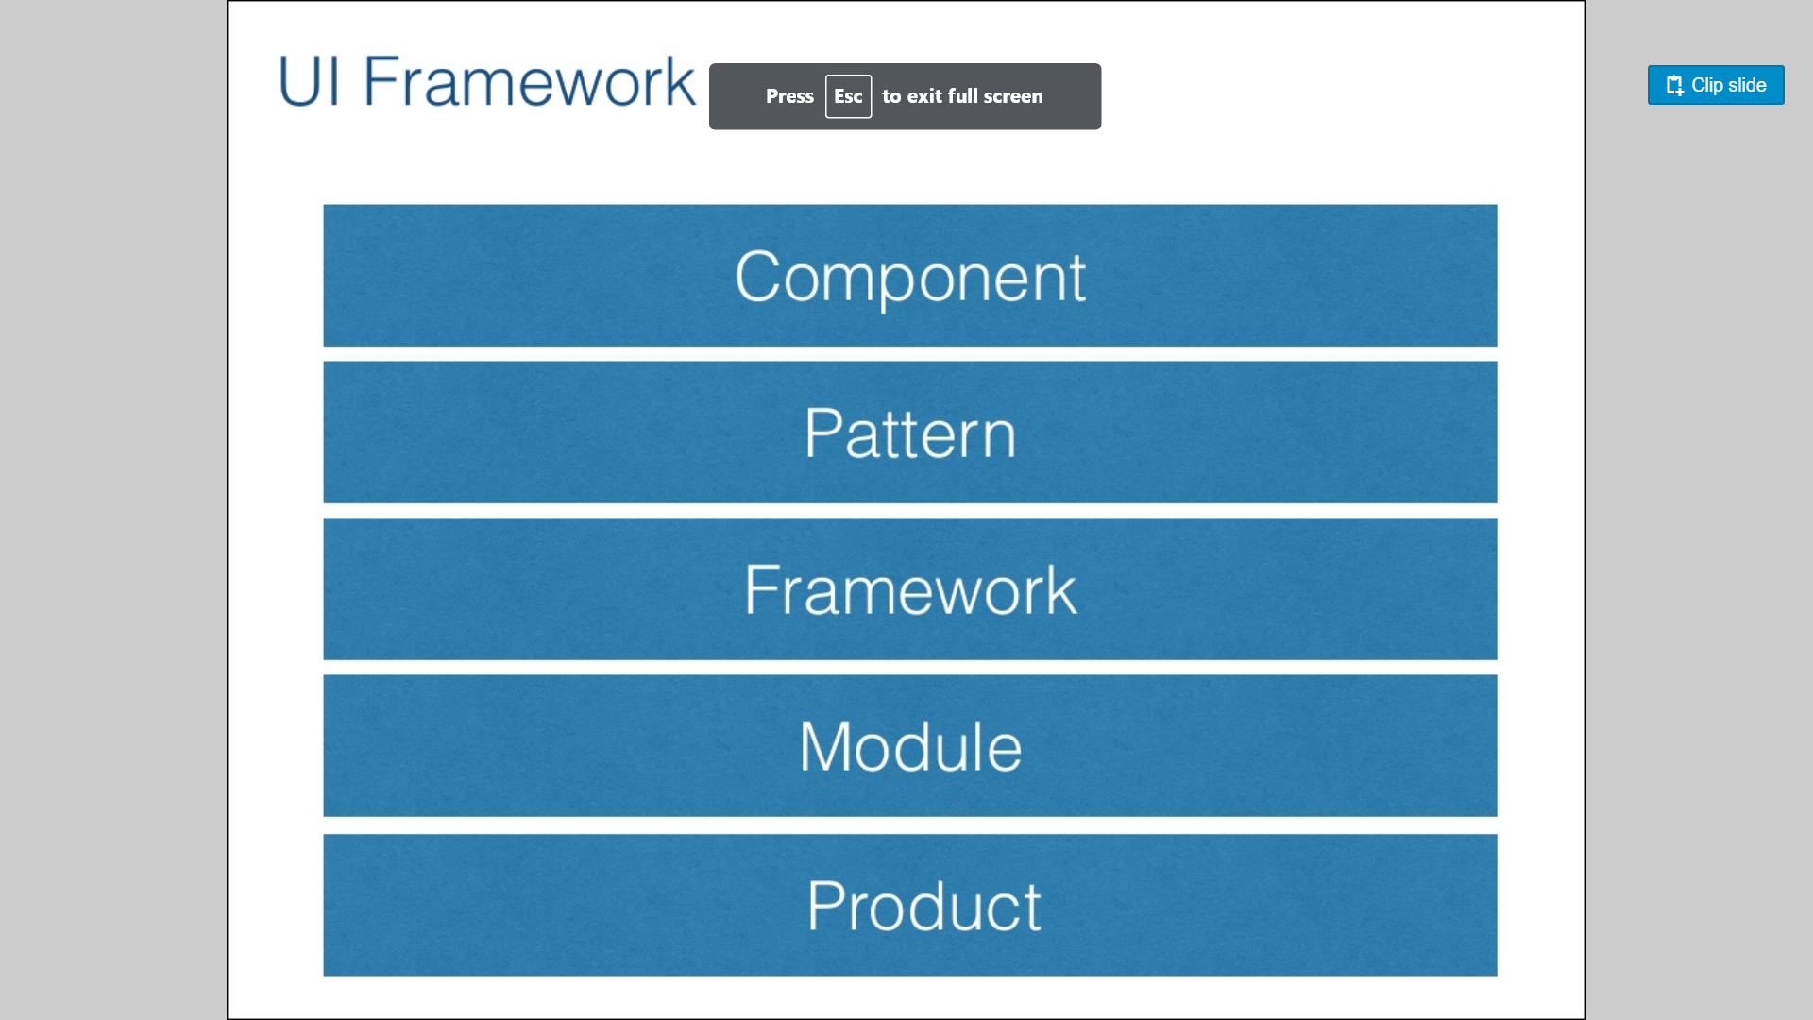

Slide 2
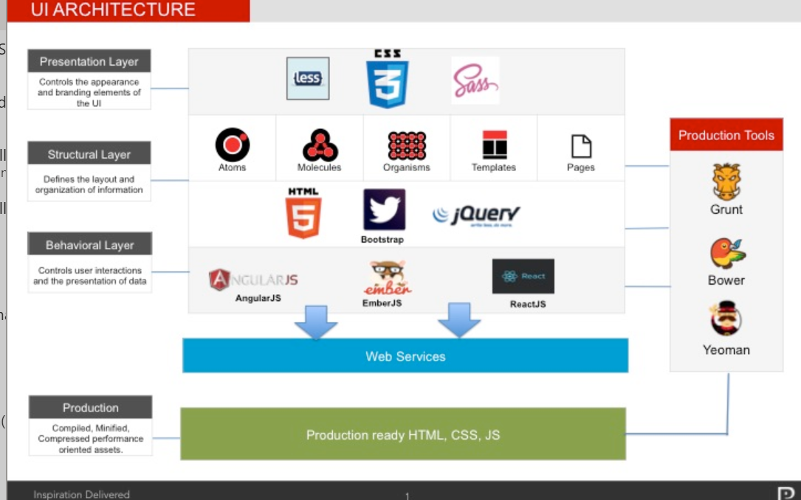

Slide 3
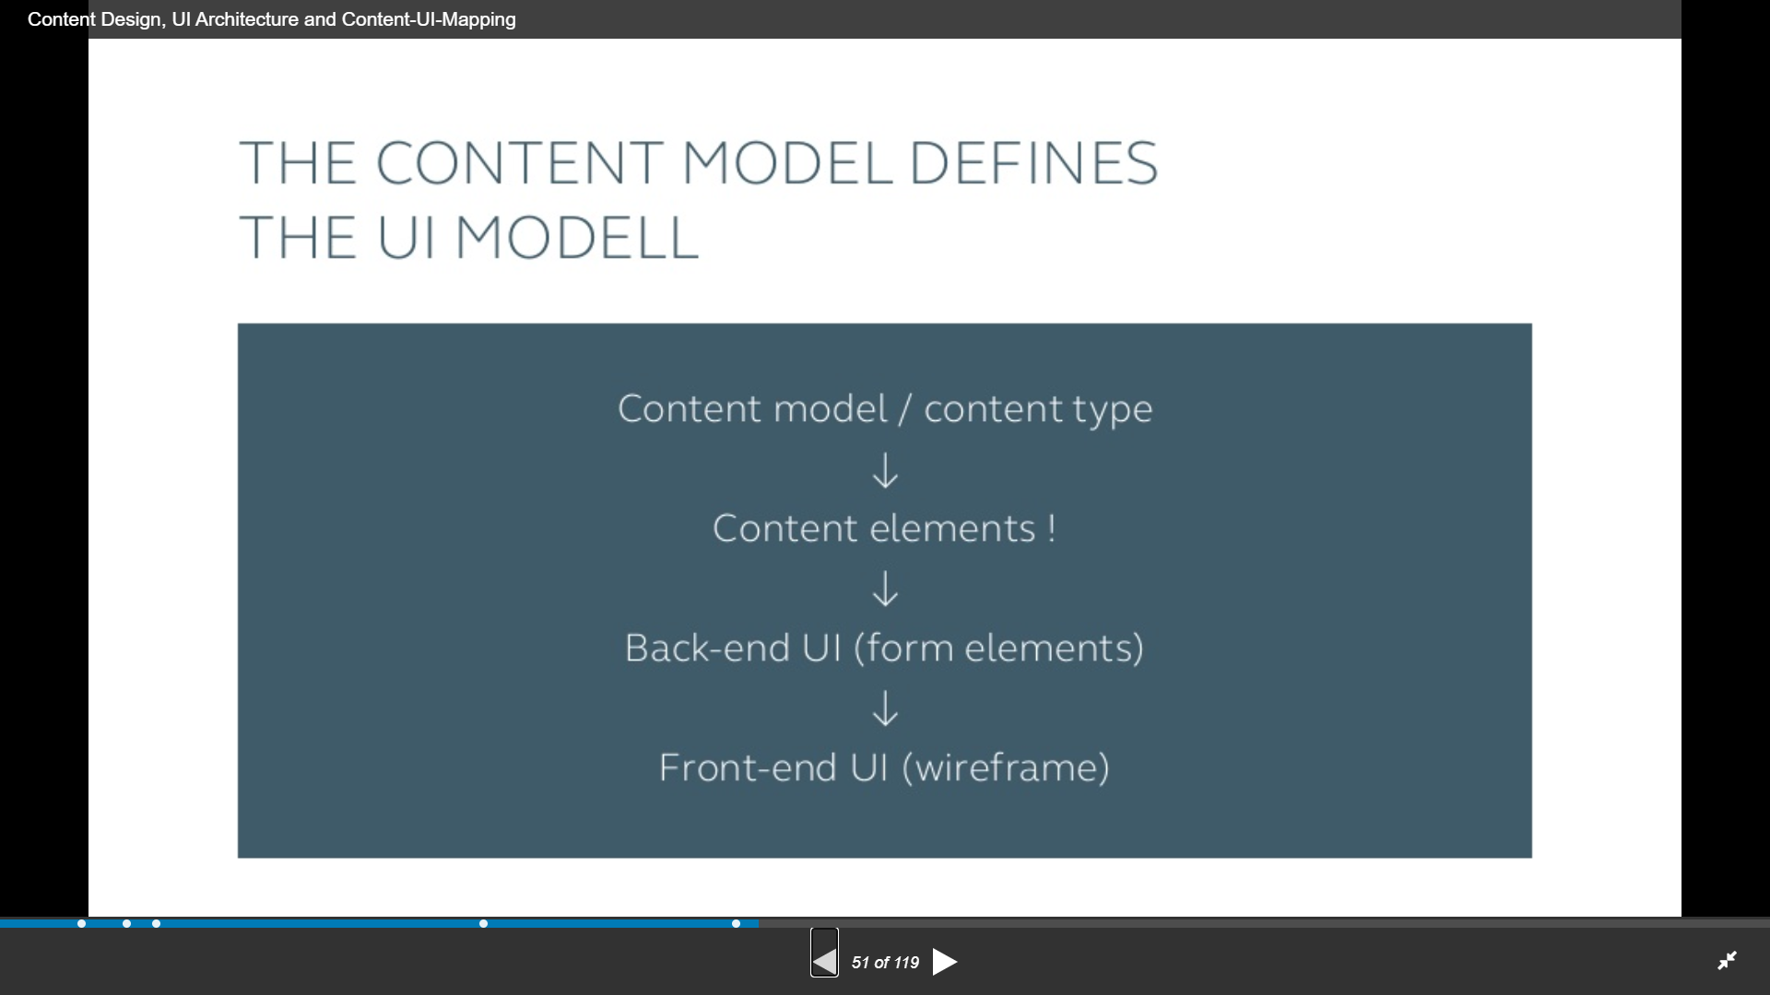

Slide 4
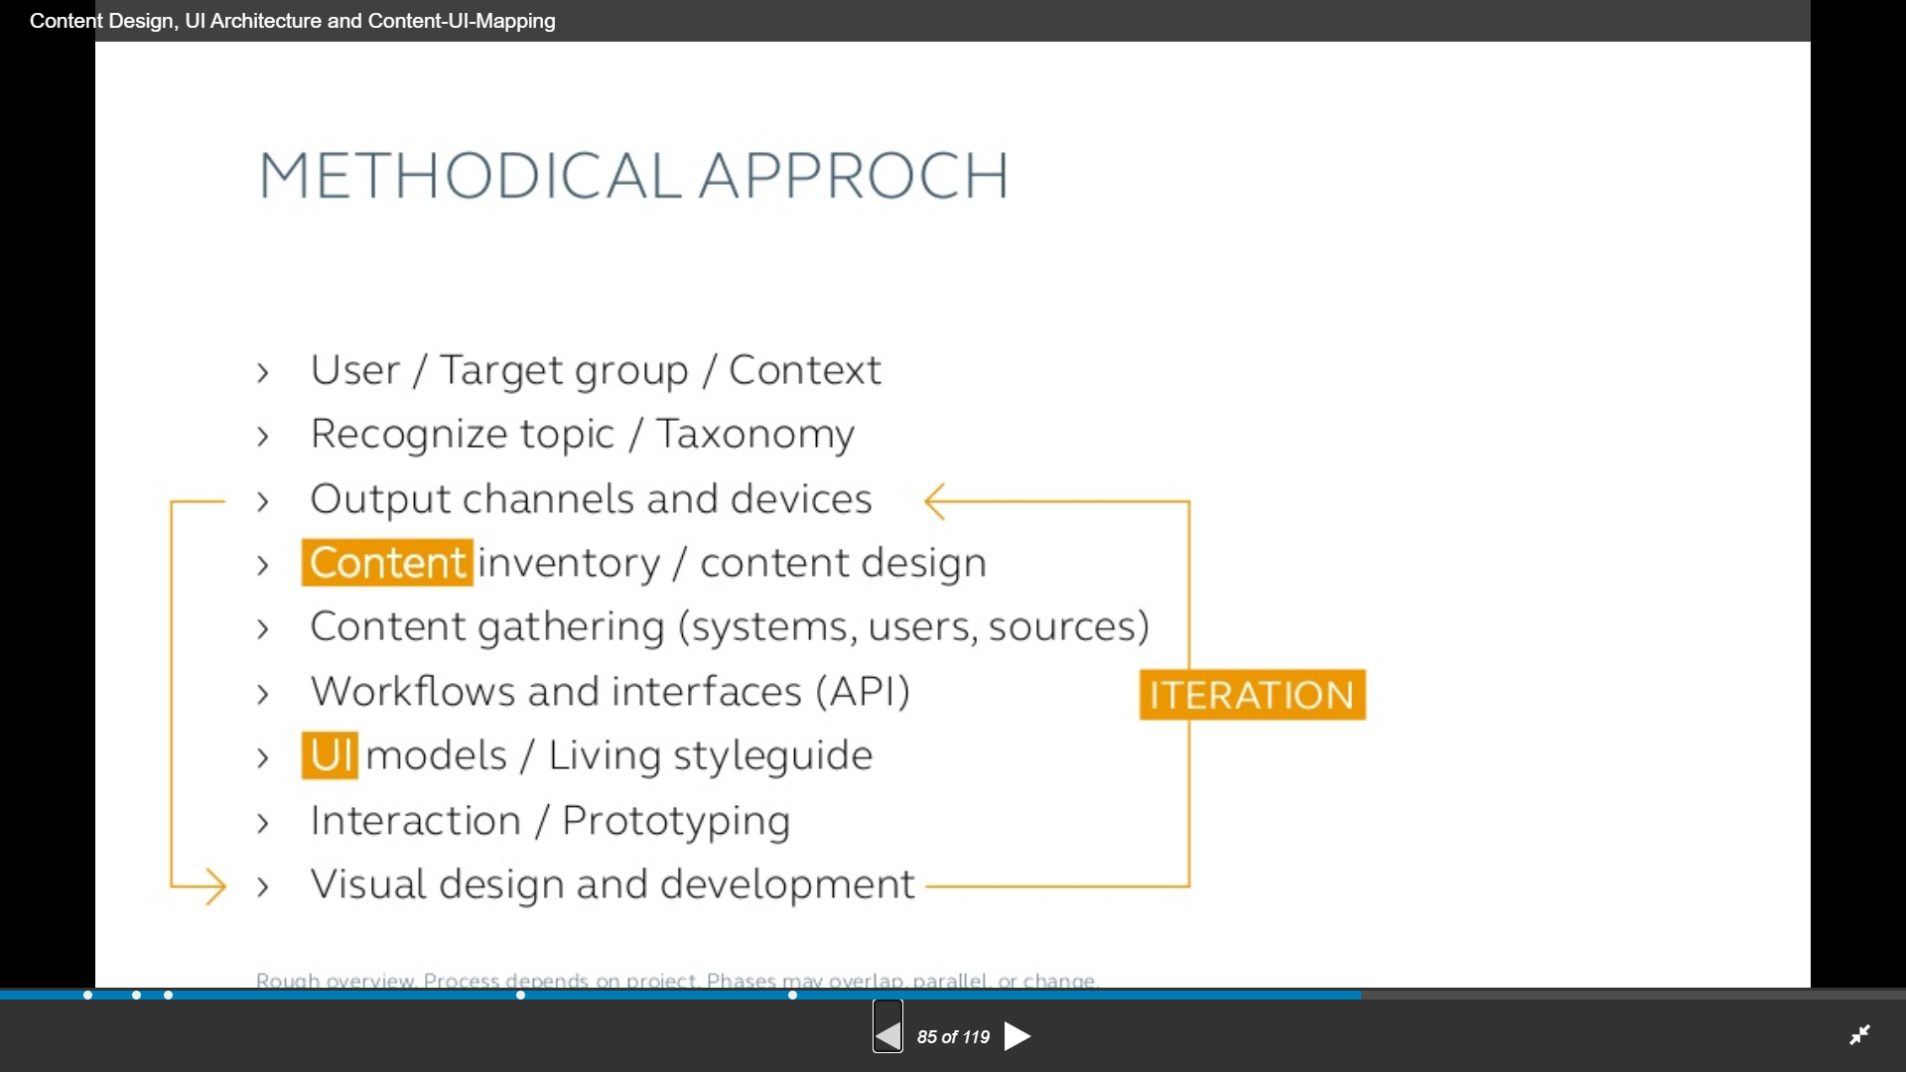

Slide 5
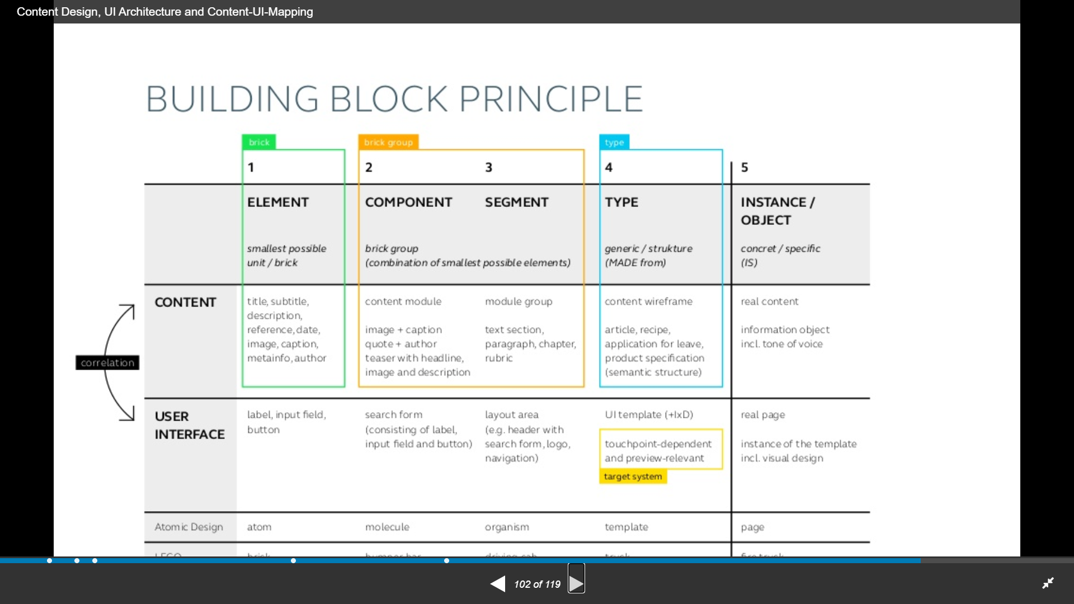

Slide 6
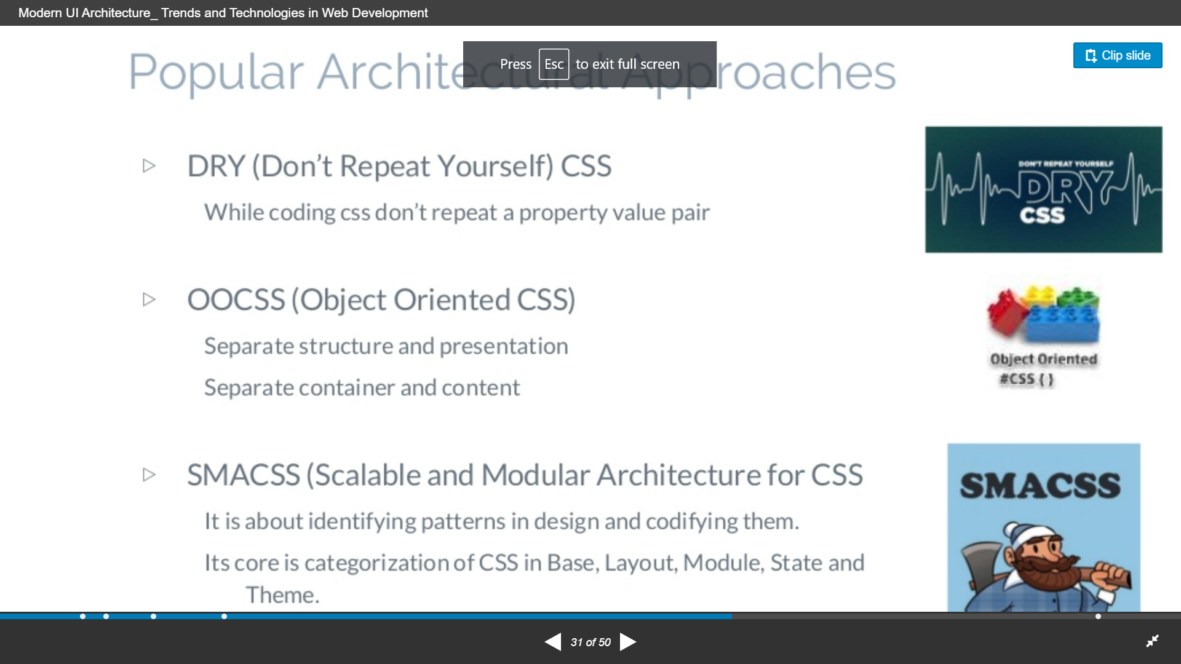

Slide 7
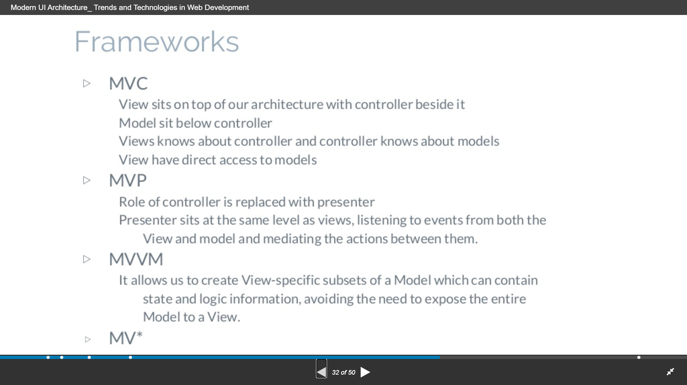

Slide 8
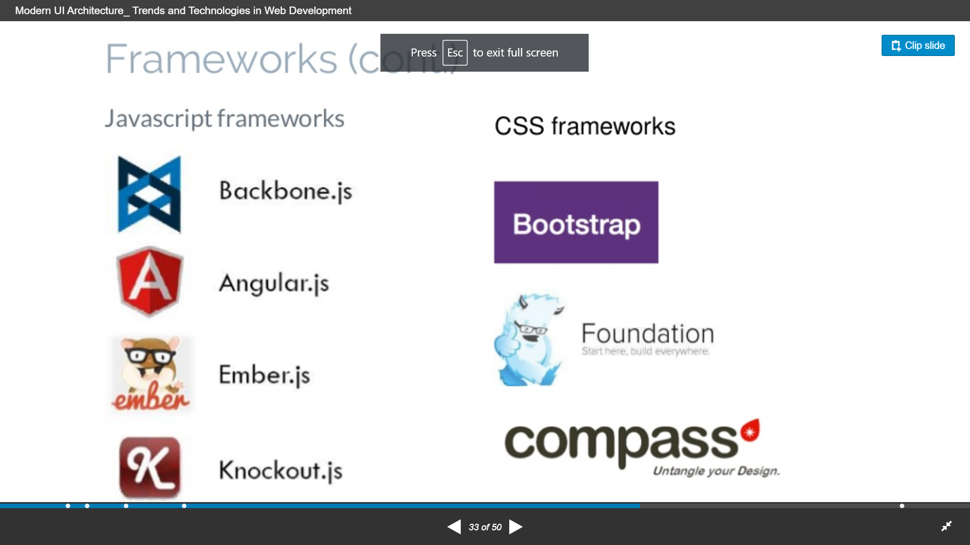

Slide 9
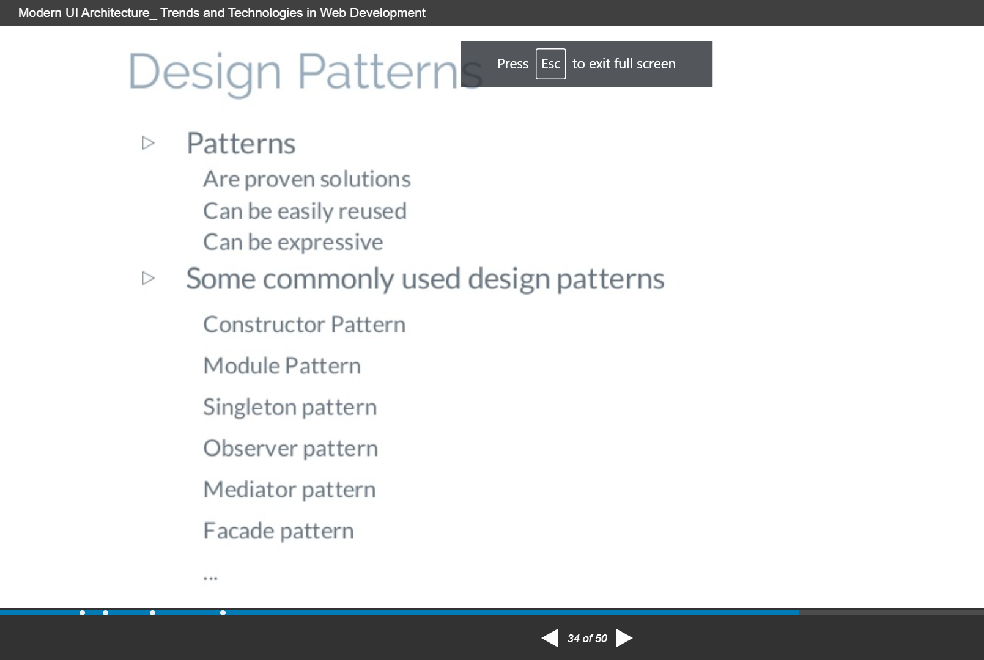

Slide 10
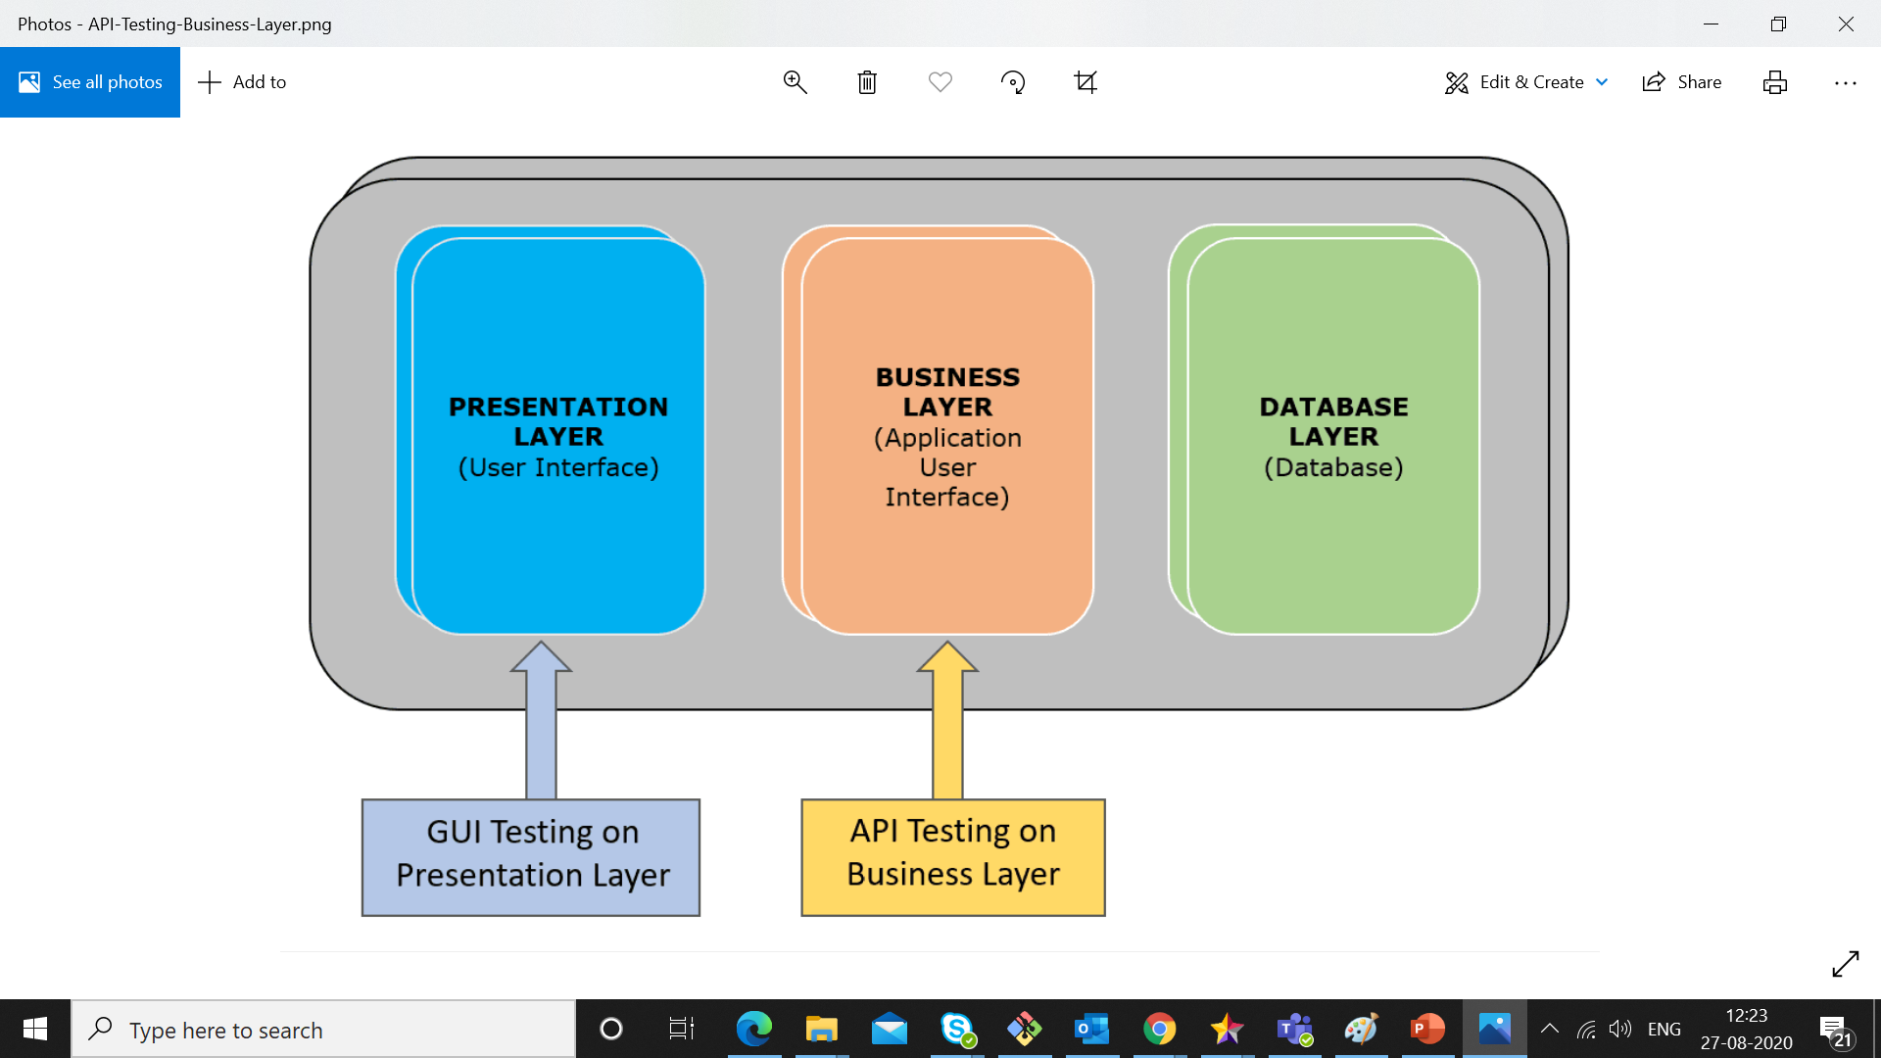

Slide 11
tools
Jest
Protractor
Jasmine
Postman
Fiddler
Other tools

Slide 12
Flask – angular –chart- Django software
Angular 7.x
Python 3.x with pip pandas and other libray numpy
Python api
Charts
D3.js
Ngx chart
Powerbi client npx client angular intergretion-embed from device 42
Django pyton-angular

Slide 13
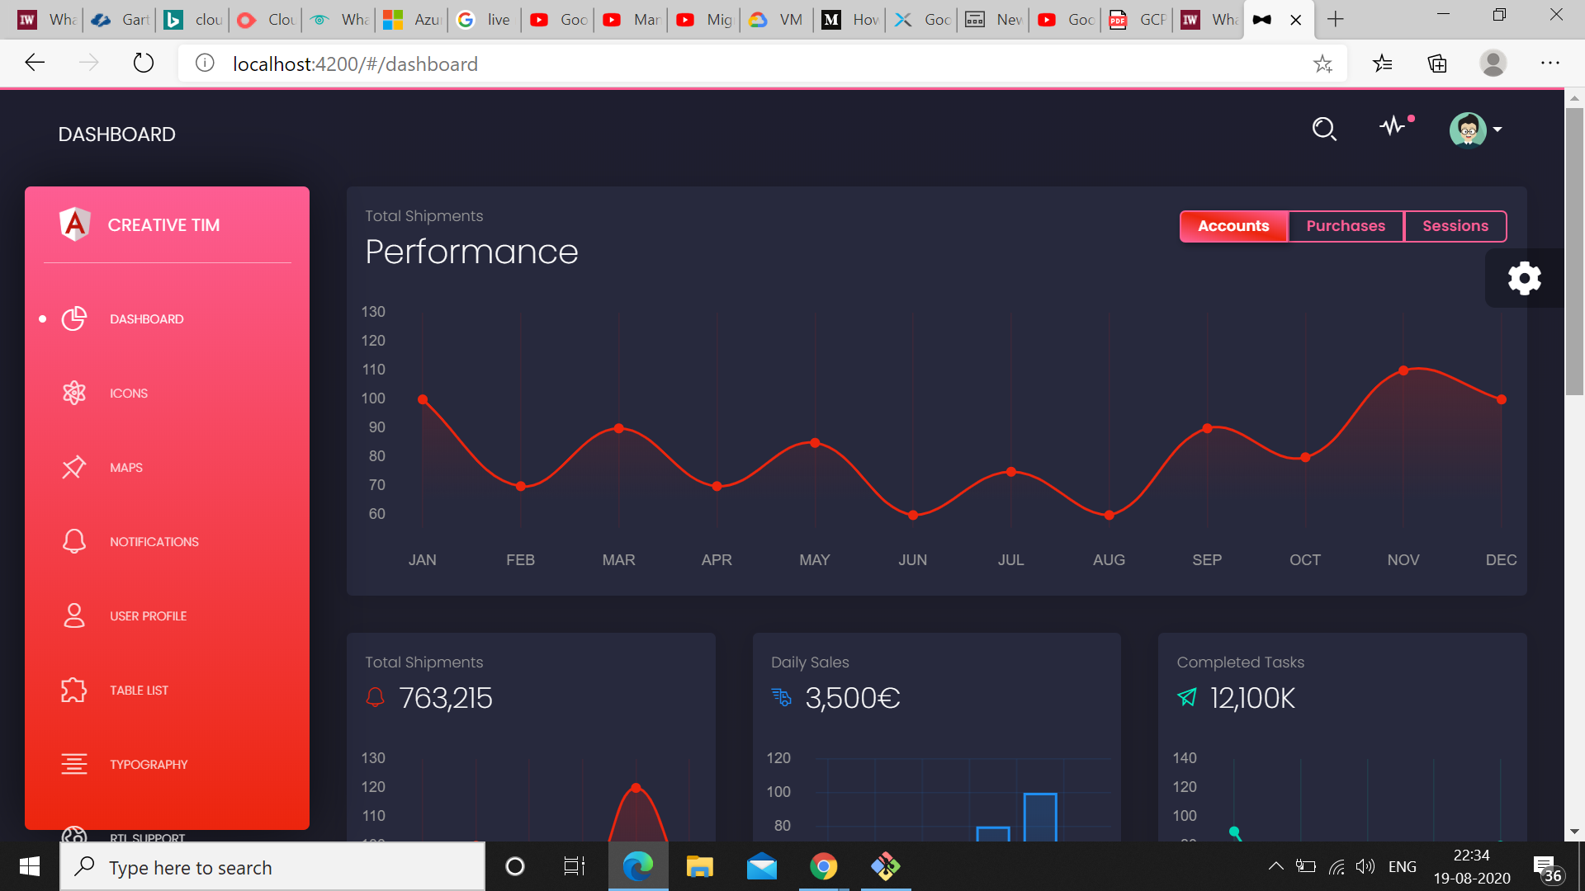
Black –dashboard app

Slide 14
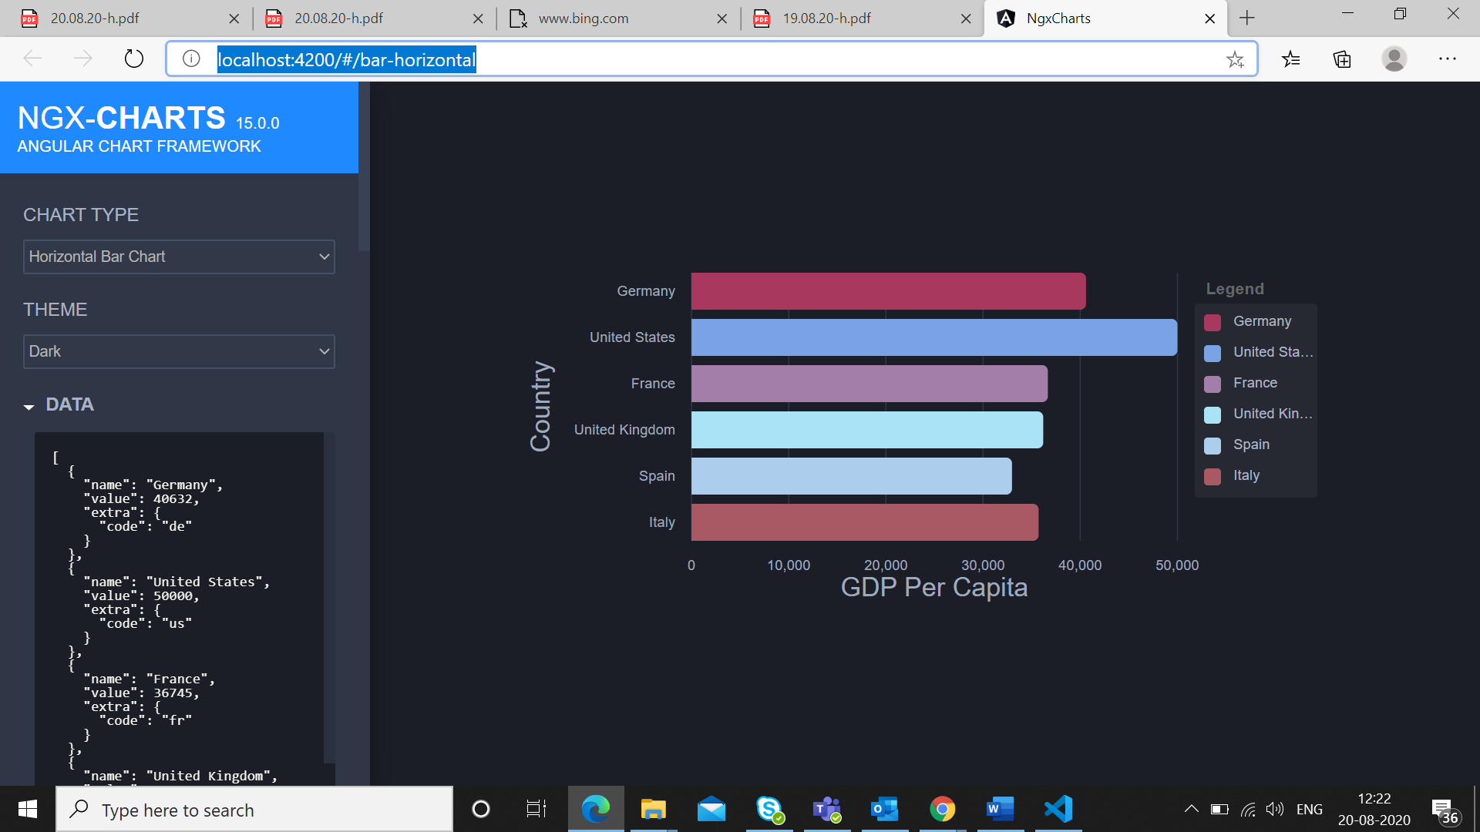
Ngx-chart

Slide 15
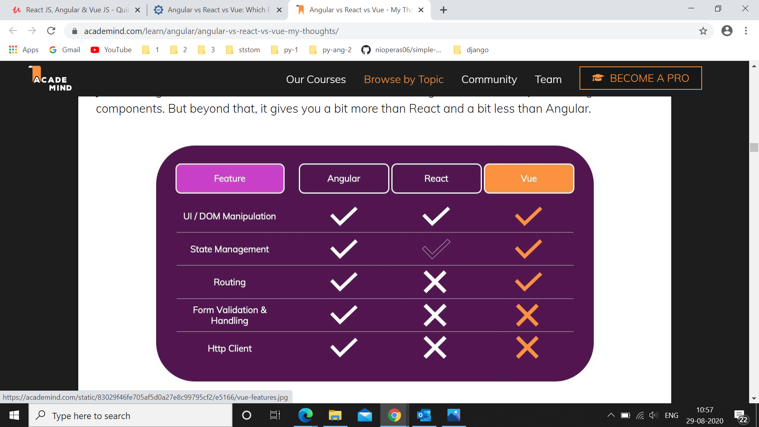

Slide 16
Style guides
https://coschedule.com/blog/editorial-style-guide-template/#best-practices
https://www.canva.com/learn/50-meticulous-style-guides-every-startup-see-launching/
https://angular.io/guide/docs-style-guide
https://angular.io/guide/styleguide
https://dev.to/aziziyazit/style-guide-driven-development-using-angular-storybook-560b
https://www.toptal.com/designers/ui/ui-styleguide-better-ux

